Slide 1
(Digital) Paper Figures

Slide 2
1. Multinomial Markov

Slide 3
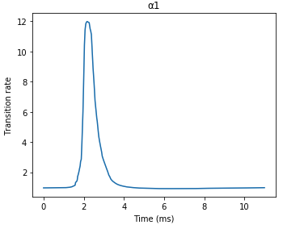
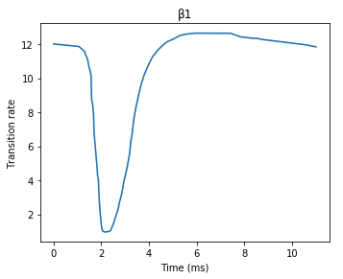
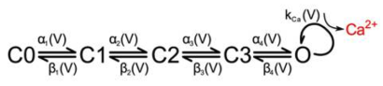
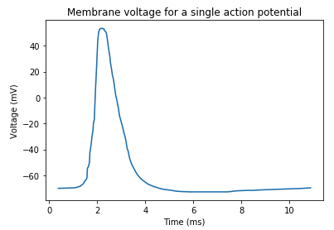
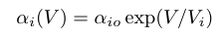
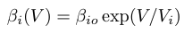
Voltage-Gated Calcium Channel
Transition rates:
Transition probabilities:

Slide 4
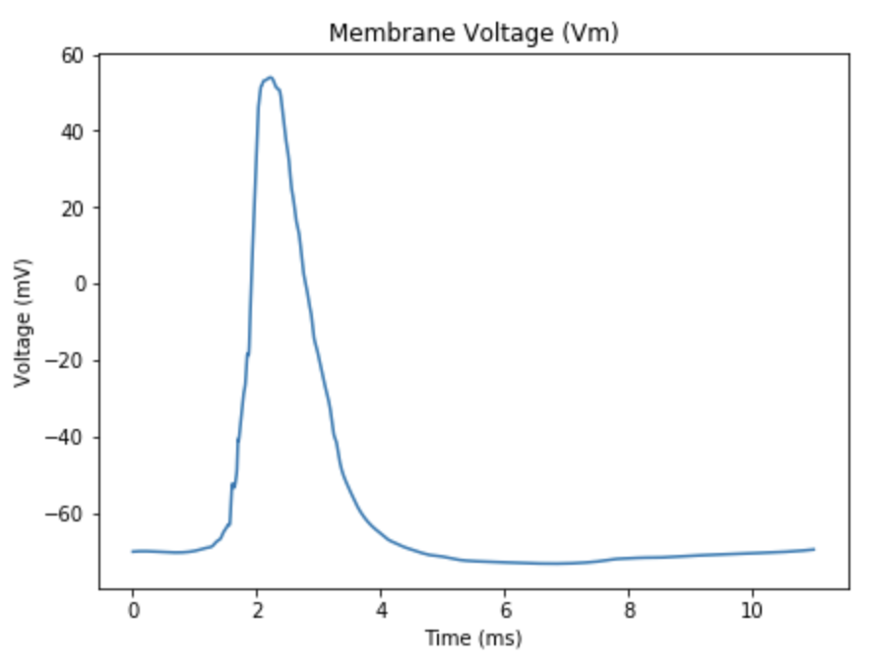
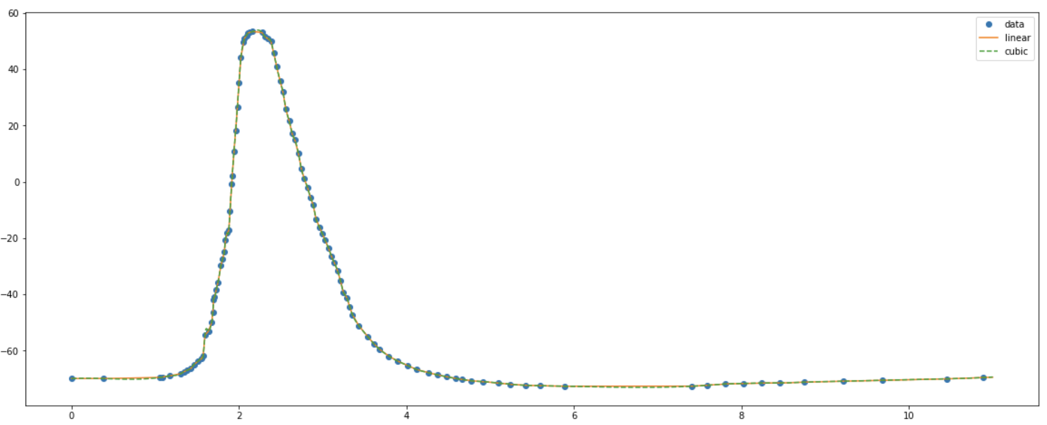
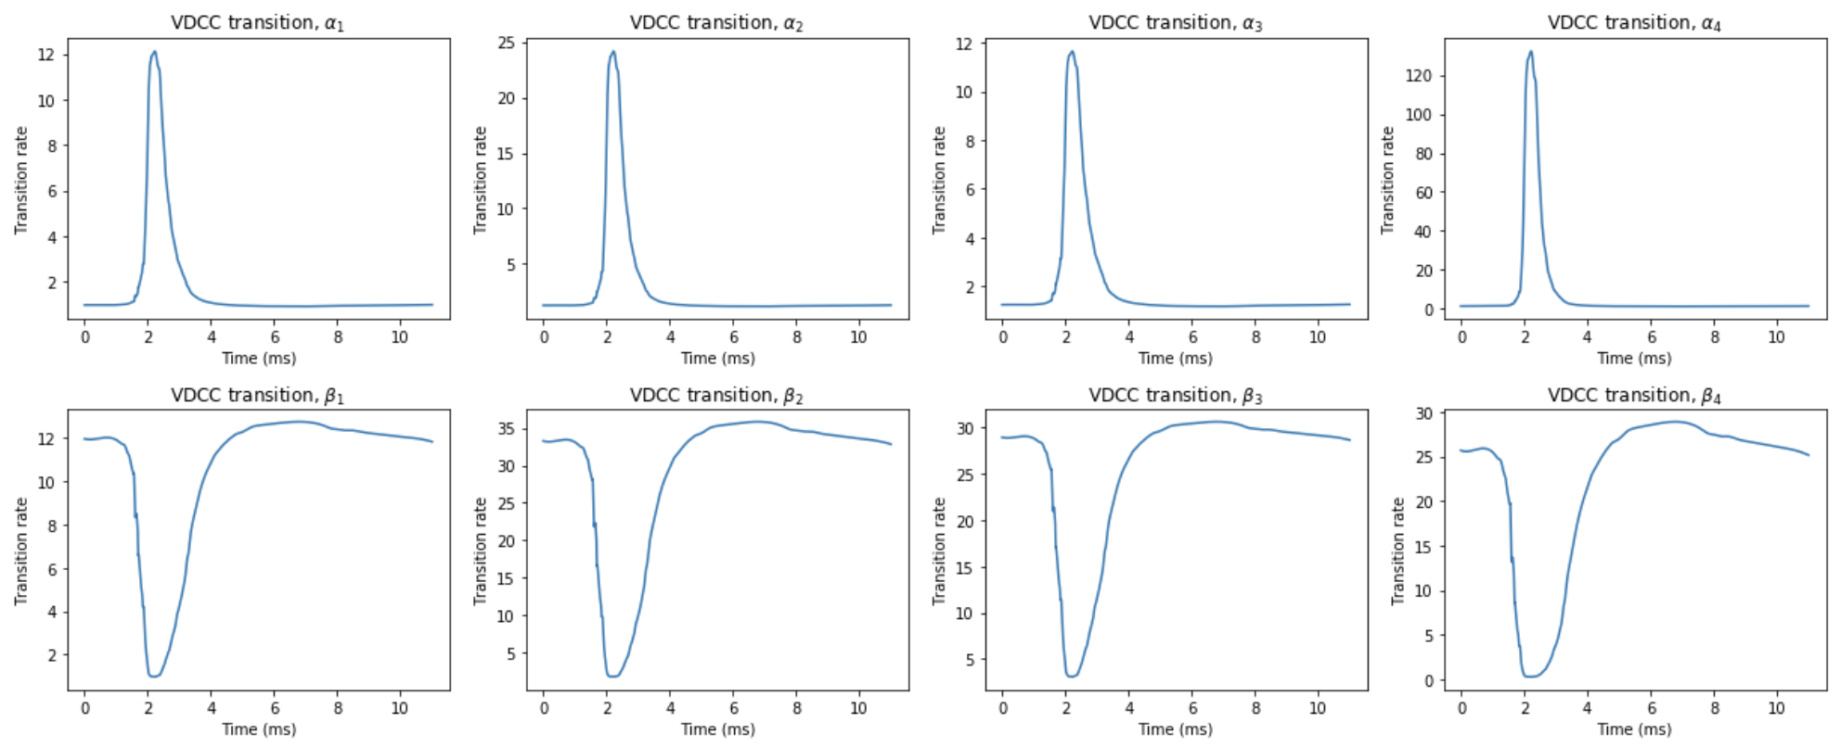
Action Potential and State Transitions
Notes:
-

Slide 5
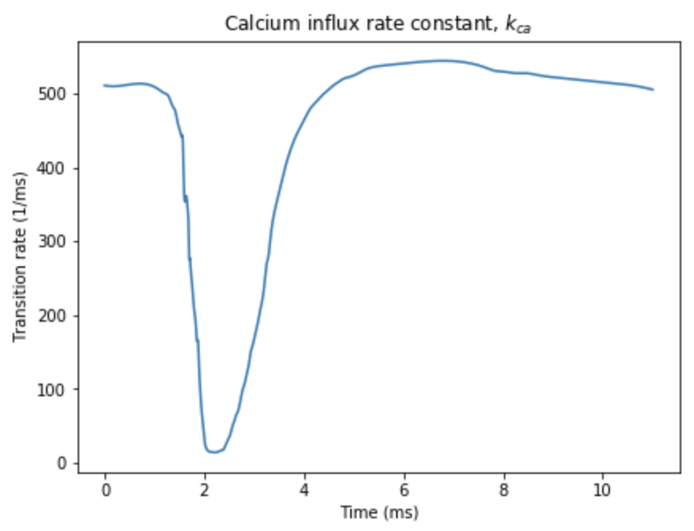
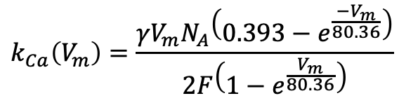
Calcium Influx
$$k_{Ca}\left(V_{m}\right)=\frac{γV_{m}N_{A}\left(0.393−e^{\frac{−V_{m}}{80.36}}\right)}{2F\left(1−e^{\frac{V_{m}}{80.36}}\right)}$$
Notes:
- Paper reference

Slide 6
VDCC Solutions - MCell

Slide 7
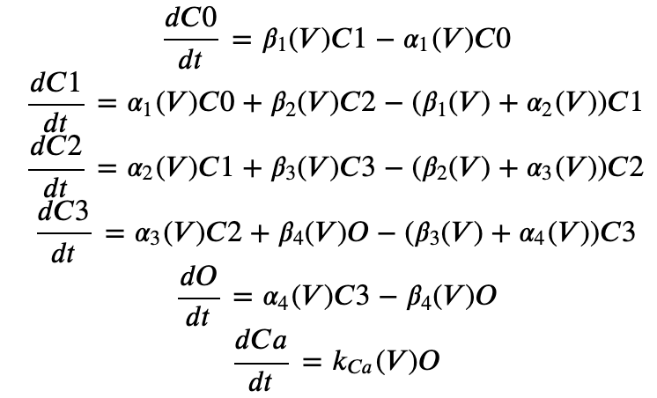
VDCC Solutions - ODE
Notes:
- Supplemental

Slide 8
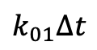
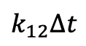
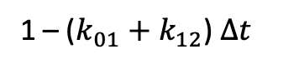
1 – ($k_{01}+k_{12}$) $∆t$
C0
$$k_{01}∆t$$
C1
$$k_{12}∆t$$
C2

Slide 9
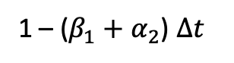
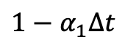
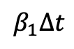
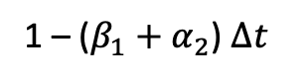
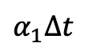
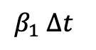
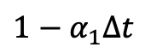
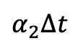
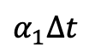
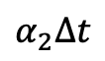
VDCC Solutions - Markov
C0
t0
C0
$$α_{1}∆t$$
C1
$$α_{1}∆t$$
$${1−α}_{1}∆t$$
t1
$${1−α}_{1}∆t$$
1 – ($β_{1}+α_{2}$) $∆t$
$$α_{2}∆t$$
$β_{1}$ $∆t$
1 – ($β_{1}+α_{2}$) $∆t$
C0
$$β_{1}∆t$$
C1
$$α_{2}∆t$$
C2
t2
Sample for Unif
Compare to probabilities to find out

Slide 10
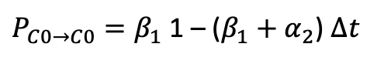
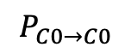
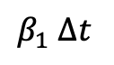
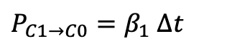
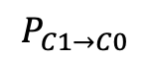
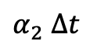
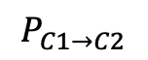
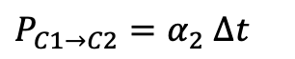
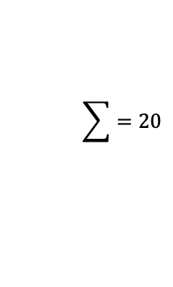
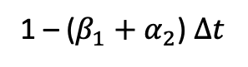
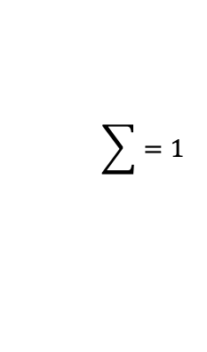
VDCC Solutions – Multinomial Markov
1 – ($β_{1}+α_{2}$) $∆t$
$P_{C1→C2}=α_{2}$ $∆t$
${P_{C1→C0}=β}_{1}$ $∆t$
C0
$β_{1}$ $∆t$
C1
$α_{2}$ $∆t$
C2
${P_{C0→C0}=β}_{1}$1 – ($β_{1}+α_{2}$) $∆t$
$$P_{C1→C2}$$
$$P_{C1→C0}$$
$$P_{C0→C0}$$
n = 1 channel
0
1
0
$$\sum{=1}$$
n = 20 channels
4
9
7
$$\sum{=20}$$
Notes:
- Add algorithmic efficiency analysis

Slide 11
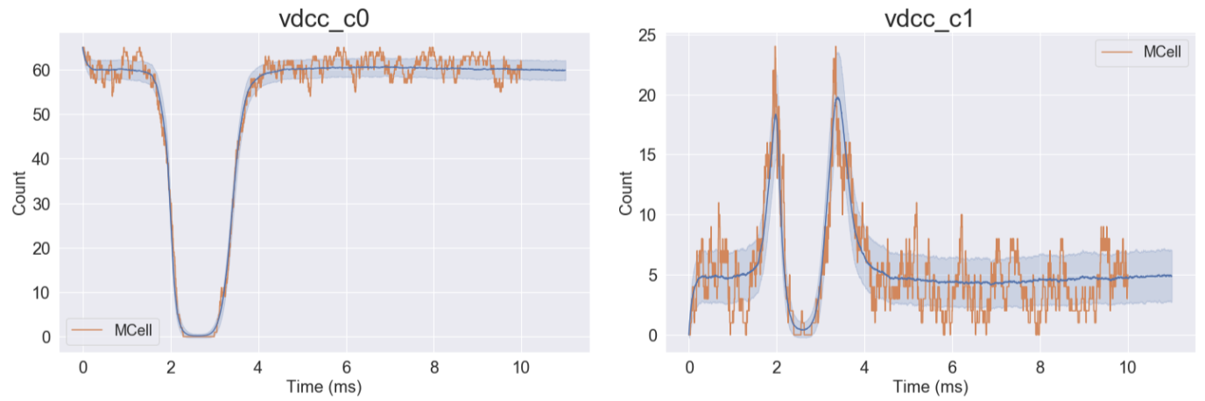
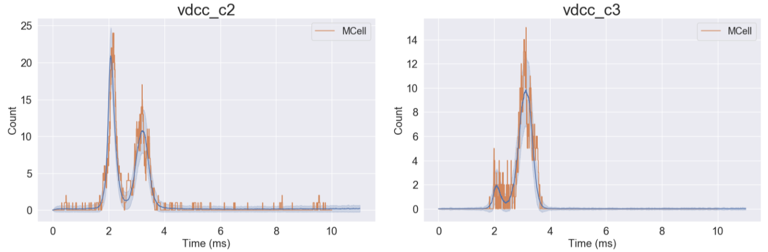
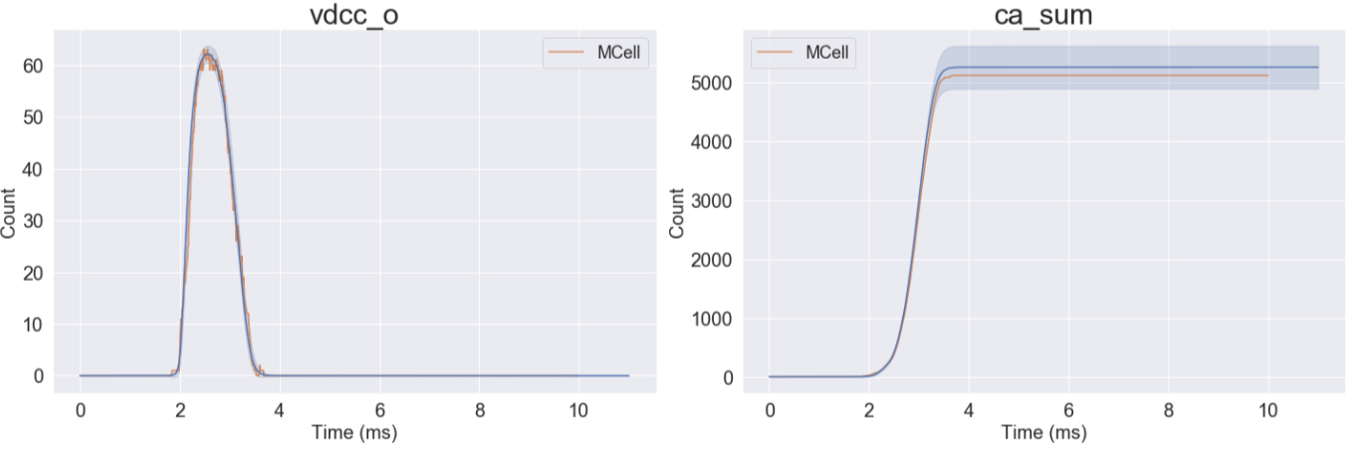
VDCC Solutions Comparison
Notes:
Rerun Mcell many times
Plot all 3 together. Make ODE more visible somehow

Slide 12
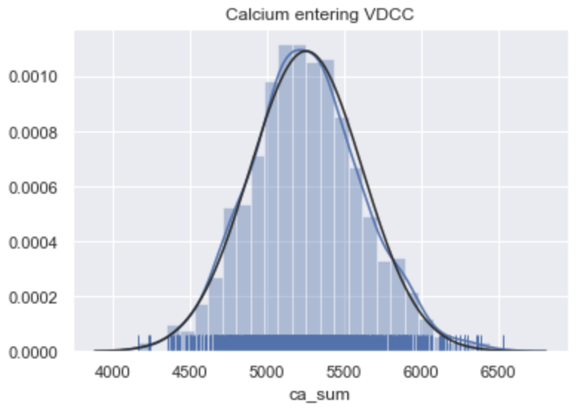
Calcium Influx

Slide 13
2. Operator Splitting
Calcium binding and diffusion upon influx into axon.

Slide 14
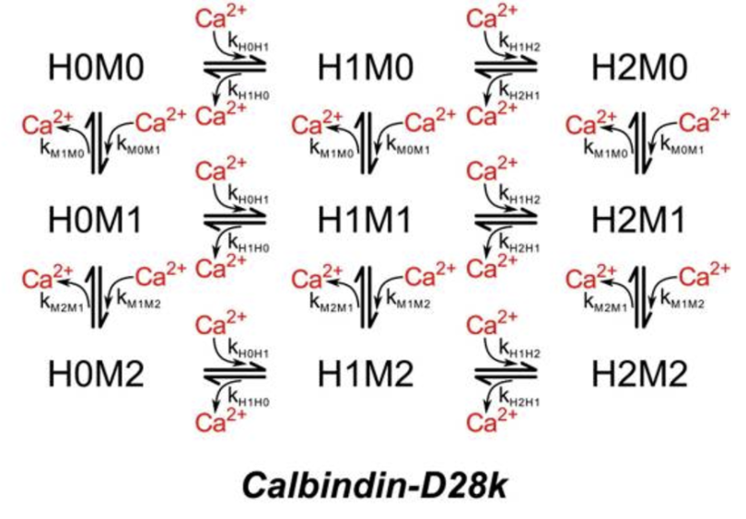
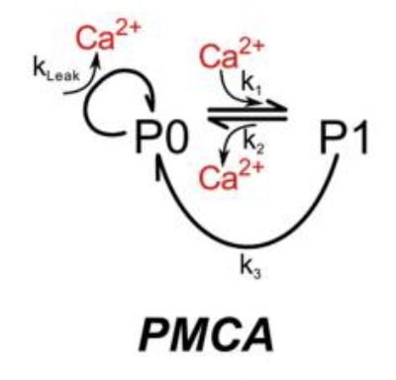
Calcium Binding

Slide 15
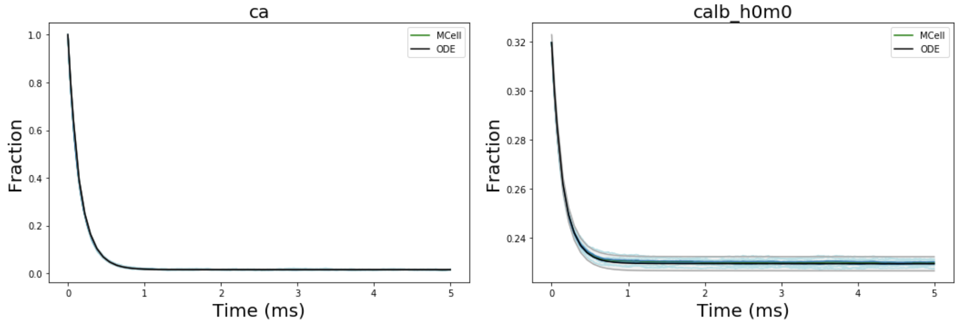
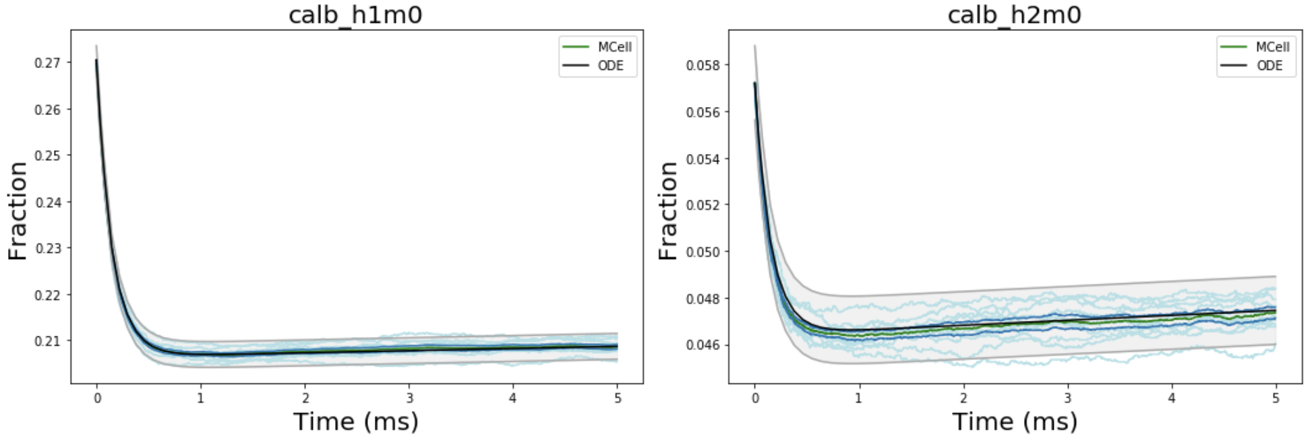
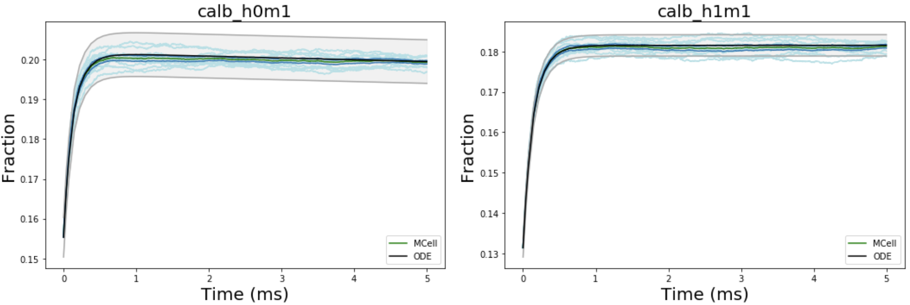
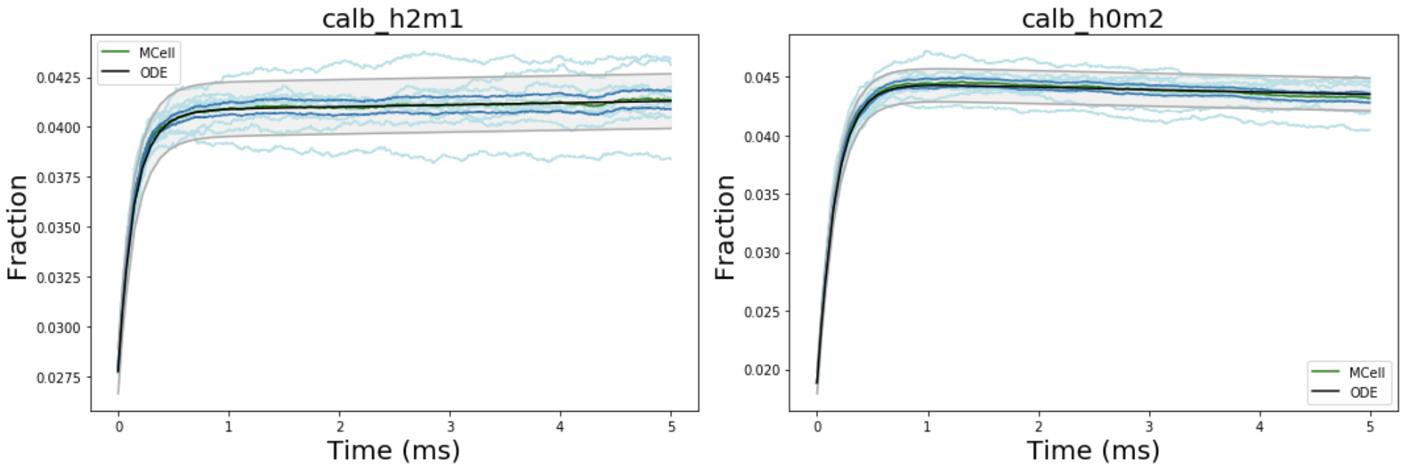
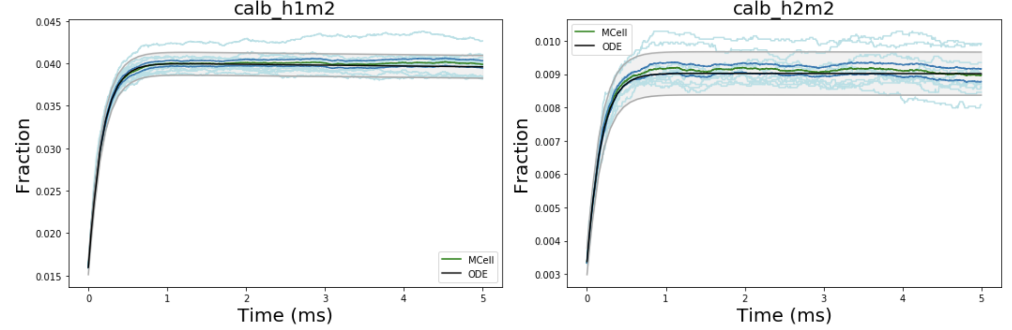
Impact of Calbindin
Notes:
Conclusion: unbinding has little impact
Fix legend to specify solution types
Maybe run Mcell with very high diffusion constant
Rerun with fewer calcium (OOM)

Slide 16
Calbindin Markov…

Slide 17
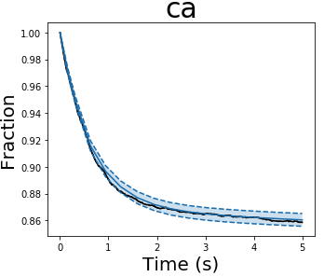
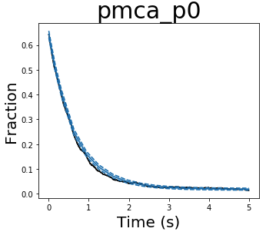
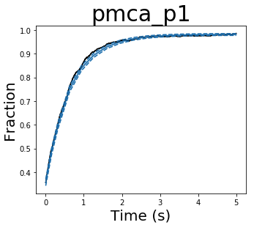
Impact of PMCA

Slide 18


Slide 19










t₀
0
$$P_{01}$$
t₁
0
1
$$P_{01}$$
$$1−P_{01}$$
$$1−P_{01}$$
$$P_{10}$$
$$P_{12}$$
t₂
0
1
2
$$P_{10}$$
$1−(P_{10}$+ $P_{12}$)
$$P_{12}$$
$1−(P_{10}$+ $P_{12}$)

Slide 20



$P_{C1→C2}=α_{2}$ $∆t$
${P_{C1→C0}=β}_{1}$ $∆t$
${P_{C0→C0}=β}_{1}$1 – ($β_{1}+α_{2}$) $∆t$

Slide 21




(A)
(C)
Open VDCC Channels
1.0
0.8
0.6
(B)
Open VDCCs
0.4
Markov
MCell
ODE
0.2
0.0
1.5
2.0
2.5
3.0
3.5
4.0
4.5
5.0
time (ms)

Slide 22
(B)
(A)

Slide 23
(B)
(A)

Slide 24


Slide 25


Slide 26


Slide 27
A
B
y
y
z
x
0.5 μm
z
0.25 μm

Slide 28

Fraction of Open VDCCs
1.0
Markov
MCell
0.8
ODE
0.6
Fraction
0.4
0.2
0.0
1.0
1.5
2.0
2.5
3.0
3.5
4.0
4.5
Time (ms)
Notes:
Fix time to start from zero (subtract 1); no title; title as y-axis (all lowercase!!!!!!!!!!!!!!!!!!!!!!!!!!!!!!!!!!!!!!!!!!); 30% font size difference

Slide 29
Fraction of Open VDCCs
1.0
Markov
MCell
0.8
ODE
Fraction
0.6
0.4
0.2
0.0
1.0
1.5
2.0
2.5
3.0
3.5
4.0
4.5
Time (ms)

Slide 30

Calcium Influx per VDCC
140
Markov
120
MCell
ODE
100
80
Calcium Count
60
40
20
0
1.0
1.5
2.0
2.5
3.0
3.5
4.0
4.5
Time (ms)

Slide 31
Calcium Influx per VDCC
140
Markov
Markov
120
MCell
MCell
ODE
ODE
100
Calcium Count
80
60
40
20
0
1.0
1.5
2.0
2.5
3.0
3.5
4.0
4.5
Time (ms)
Notes:
Start and stop at some even number(?)

Slide 32

Difference in VDCCs Open Compared to ODE Solution
ODE - Markov
0.20
ODE - MCell
0.15
Fraction
0.10
0.05
0.00
1.0
1.5
2.0
2.5
3.0
3.5
4.0
4.5
Time (ms)

Slide 33
(ODE – Markov)
0.20
(ODE – MCell)
0.15
Fraction
0.10
0.05
0.00
1.0
1.5
2.0
2.5
3.0
3.5
4.0
4.5
Time (ms)

Slide 34
Difference in VDCCs Open Compared to ODE Solution
Difference in Calcium Influx per VDCC

Slide 35

Difference in Calcium Influx per VDCC
40
35
ODE - Markov
ODE - MCell
30
25
Fraction
20
15
10
5
0
1.0
1.5
2.0
2.5
3.0
3.5
4.0
4.5
Time (ms)

Slide 36
40
35
30
(ODE – Markov)
(ODE – MCell)
25
Fraction
20
15
10
5
0
1.0
1.5
2.0
2.5
3.0
3.5
4.0
4.5
Time (ms)

Slide 37
VDCC
 | MCell | Standard Markov | Optimized Markov
Runtime | 90.4 +- 4.5 s | 50.3 +- 0.76 s | 6.45 +- 0.76 s
Time Complexity | -- | O(NST) | O(T)
FLOPs
Calbindin
 | MCell | Standard Markov | Optimized Markov
Runtime | 21.08 +- 0.26s | -- | 2.09 +- .06 s
Time Complexity | -- | O(NST) | O(T)
FLOPs

Slide 38


VDCC | Runtime (sec) | No. Pseudorandom Number Generator Calls (n_{PRNG}) | Total Floating-Point Operations (FLOPs)
MCell | 139.20 | 1.5 $×$ 10⁹ | 1.7$×$ 10¹¹
Standard Markov | 109.16 | 6.5 $×$ 10⁵ | 7.0$×$ 10⁷
Multinomial Markov | 9.40 | 1.0 $×$ 10⁵ | 1.3 $×$ 10⁷
ODE (Euler) | 10.05 | 0 | 7.7 $×$ 10⁶
Calbindin | Runtime | No. Pseudorandom Number Generator Calls (n_{PRNG}) | Total Floating-Point Operations (FLOPs)
MCell | 29.34 | 6.9 $×$ 10⁷ | 8.7 $×$ 10⁹
Standard Markov | 76.78 | 2.7 $×$ 10⁸ | 1.4 $×$ 10¹⁰
Multinomial Markov | 2.37 | 3.6 $×$ 10⁵ | 2.7 $×$ 10⁷
ODE (Euler) | 0.72 | 0 | 1.6 $×$ 10⁶
* accuracy loss with deterministic solution
Notes:
Updated 10/5/21

Slide 39
Complexity | Time Complexity | Space Complexity
MCell | O(b n t) | O(b n log₂s)
Standard Markov | O(b n t) | O(b n log₂s)
Multinomial Markov | O(b s t) | O(b s log₂n)
ODE (Euler) | O(b s t) | O(b s log₂n)
n (total number of molecules), s (total number of states), b (number of branching states), t (number of timepoints)
Markov – number of states (number of equations), number of molecules, number of adjacent/fan-out states, time
Multinomial/ODE – number of states, time (number of adjacent states?)
Mcell
O

Slide 40





Computational Systems Neuroscience
Brain
1 m
Systems
Maps
1 cm
Networks
Neurons
100 μm
Multi-scale levels of investigation in analysis of the central nervous system (adapted from Churchland and Sejnowski 1992) and corresponding neuromorphic synthesis of highly efficient silicon cognitive microsystems. Boltzmann statistics of ionic and electronic channel transport provide isomorphic physical foundations.
V_{Pre}
Analysis
Synthesis
E_{Reversal}
V_{Post}
Synapses
Pre
1 μm
C_{Membrane}
Post
Source
Gate
Drain
Membrane
Channels
10 nm
MOSFET
channel
Ion channel
Energy
Carriers
Gate voltage
1 Å
G. Cauwenberghs, “Reverse Engineering the Cognitive Brain,” PNAS, 2013
Neuromorphic Systems Engineering

Slide 41


Physics of Neural Computation Silicon and Lipid Membranes Mead, 1989
Gate
SiO₂
Source
Drain
poly Si
p⁺
p-Channel
p⁺
n⁻ well
p⁻ Si substrate
Gate voltage
Energy
Squid giant axon (Hodgkin and Huxley, 1952)
Voltage-dependent p-channel
Hole transport between source and drain
Gate controls energy barrier for holes across the channel
Boltzmann distribution of hole energy produces exponential decrease in channel conductance with gate voltage
Voltage-dependent conductance
K⁺/Na⁺ transport across lipid bilayer
Membrane voltage controls energy barrier for opening of ion-selective channels
Boltzmann distribution of channel energy produces exponential increase in K⁺/Na⁺ conductance with membrane voltage

Slide 42
Gate
SiO₂
Source
Drain
poly Si
p⁺
p-Channel
p⁺
n⁻ well
p⁻ Si substrate
Gate voltage
Energy

Slide 43


A
B

Slide 44
A
B

Slide 46

A
B
C

